Slide 1
Course Title:
Fundamental Calculus
Lecture # Functions
Course Teacher:
Mahtab Uddin
Assistant Professor (Mathematics)
Institute of Natural Sciences
United International University

Slide 2
Functions, Domain and Range
Definition of function
Vertical Line Test
Piecewise-Defined functions
Domain and Range of functions
Absolute value function
Even and Odd functions
One-One and Onto functions
Inverse functions
Composite function

Slide 3
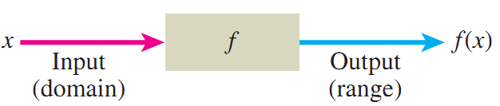
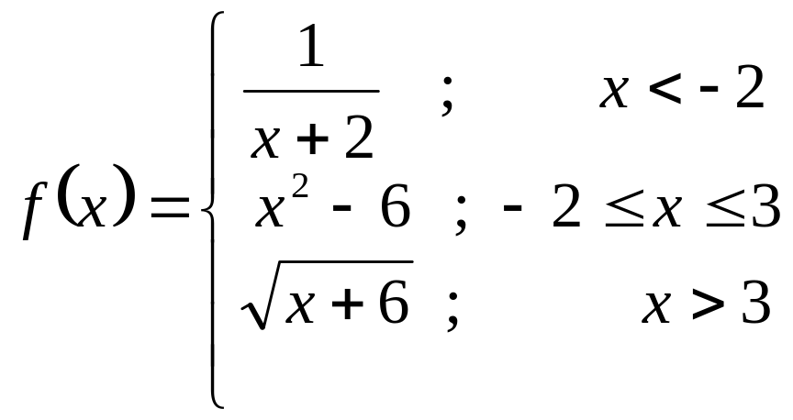
# What is Function?
Almost anything can view as a function.
The value of ‘f’
or (more specifically)
The Image of x under ‘f’
e.g. f(x) = x + 2
f(1) =3, f(2)=4
# Is it only an Equation?
Function is most general thing than an equation.
f(−3)= −1,
f(0)= −6,
f(10)= 4

Slide 4
Representation of Function:
function
y = f(x)
dependent
Variable of ‘f’
Input/ independent variable /
Argument of ‘f’
Definition of Function:
If a variable ‘x‘ in such way that each value of x determines or gives exactly one value of ‘x’ , then we say that “y is a function of x”. We can write function as y = f(x).
if x is real, then f is called real
valued function.
y = f(x)
if x is complex, then f is called
complex valued function.

Slide 5
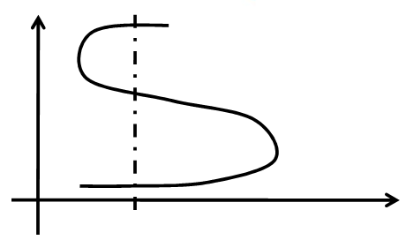
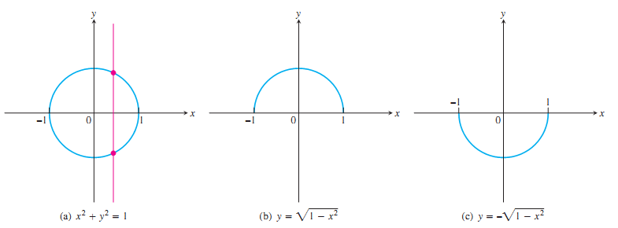
Vertical Line Test:
this curve cannot be a graph of a function.

Slide 6
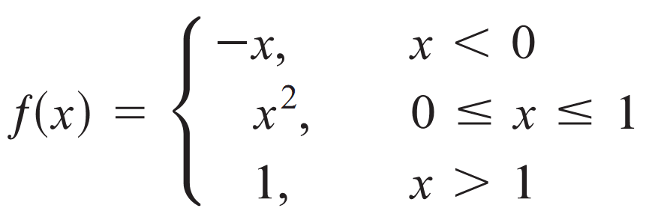
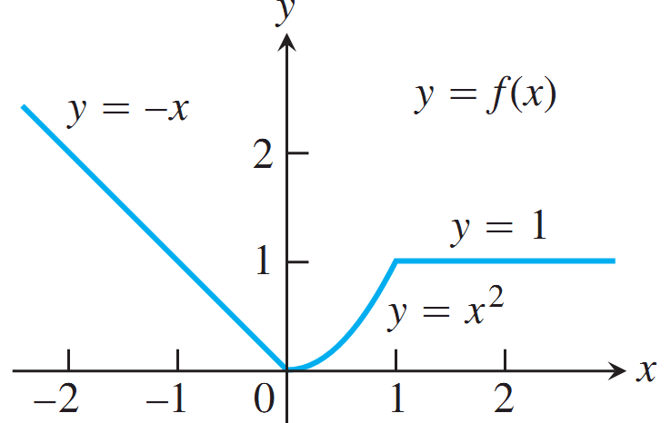
Definition: Piecewise defined function
A Piecewise function is a function that is defined on a sequence of intervals.
breakpoints
(─∞, 0)
[0, 1]
(0, +∞)

Slide 7
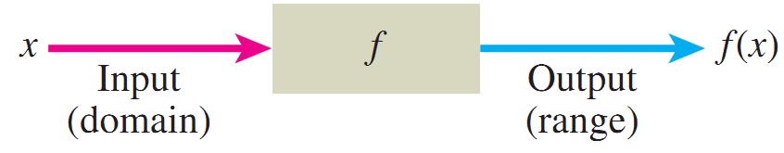
Domain and Range of a Function:
set of all allowable inputs is called Domain; D_{f}
y = f(x)
set of all outputs is called Range; R_{f}
Definition of Domain and Range:
Let y = f (x) is a function, then the set of all allowable inputs ( x- values) is called the ‘Domain of f ’, and the set of all outputs ( y- values) that result when x- varies over domain is called the ‘Range of f ’. Generally, domain of f (x) denoted by D_{f} and range of f (x) denoted by R_{f}
Example: f(x) = x+1 Domain, D_{f} = ℝ or, {x: x ∈ ℝ }
Range, R_{f} = ℝ or, {y: y ∈ ℝ }

Slide 8
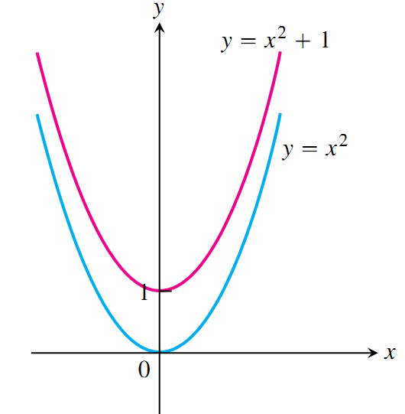
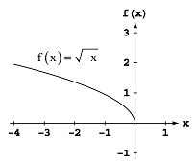

# Sketch the graph and find domain & range of the function f(x) = 1+ x²
Solution:
Here function y = f (x) is defined for every x ∈ ℝ .
∴ Domain of f, D_{f} = ℝ
For every x ∈ ℝ , the minimum value of the function is 1 and maximum value is ‘infinity’.
So, range of f, R_{f} = [1, ∞) ▄
# Sketch the graph and find the domain
and range of the function
Solution:
The function y = f (x) is defined for every
value of x if − x ≥ 0, ⇒ x ≤ 0 .
∴ Domain, D_{f} = (− ∞, 0]
For every x ∈ (− ∞, 0), we get y ≥ 0.
∴ Range, R_{f} = [0, ∞) ▄

Slide 9
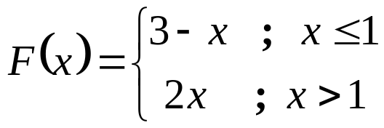
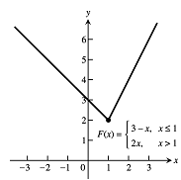
# Sketch and find the domain and range of the function
Solution:
Here the function y = F(x) is defined for x ≥ 1 and x < 1.
∴ Domain, D_{F} = (− ∞, 1] ∪ (1, ∞)
= (− ∞, ∞)
For every x ∈ (− ∞, ∞), the minimum
value of y is 2 and maximum
value is ‘infinity’.
∴ Range, R_{F}= [2, ∞) ▄

Slide 10
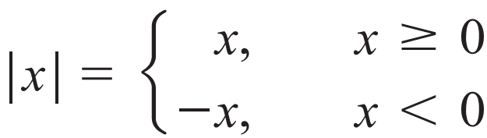
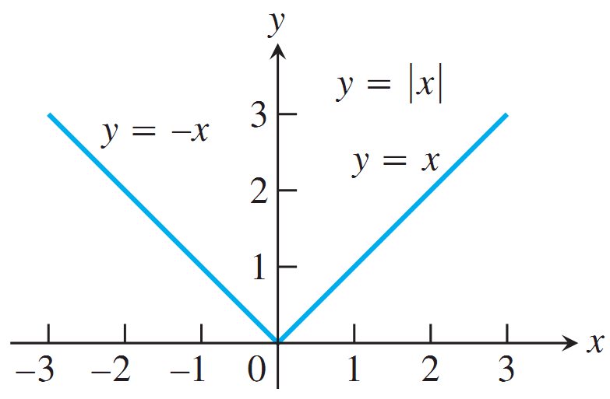
Absolute Value Function:

Slide 11
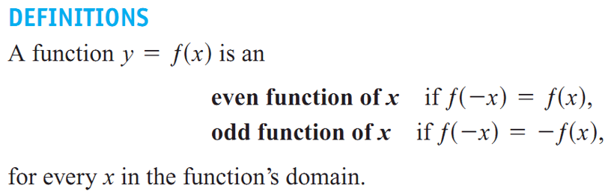
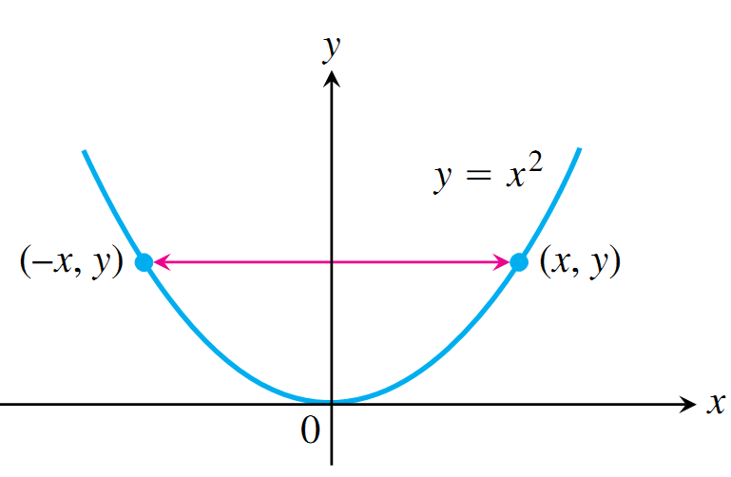
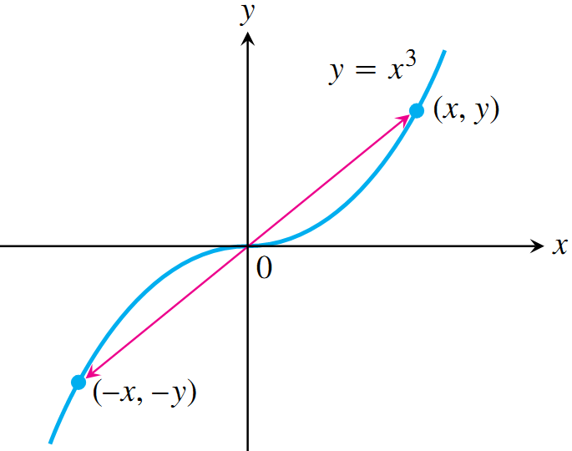
EVEN AND ODD FUNCTIONS:
Fig: Even Function
Fig: Odd Function

Slide 12
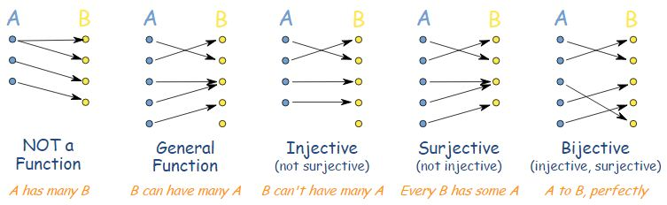
ONE-ONE (INJECTIVE) and ONTO (SURJECTIVE) FUNCTIONs
Definition (one-one):
A function y = f (x) is said to be one-one if and only if every input has distinct image, i.e. if f (x₁) ≠ f (x₂) whenever x₁ ≠ x₂ .
Definition (onto):
For any onto function, y = f (x), all the elements in output set should have an input in the input set, i.e. f is defined form A to B said to be onto if it satisfies f (A) = B.

Slide 13
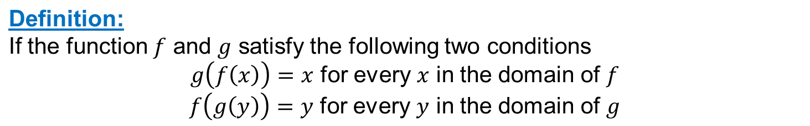
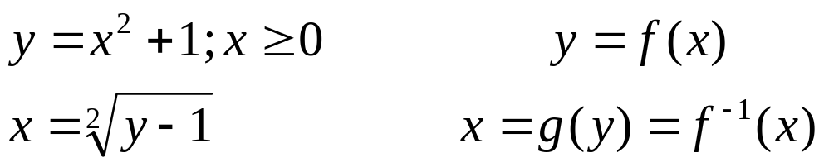
INVERSE FUNCTIONS
Domain of f ⁻¹ = Range of f
Range of f ⁻¹ = Domain of f
f^{- ─1}

Slide 14

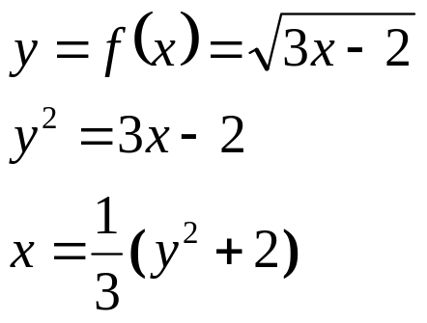
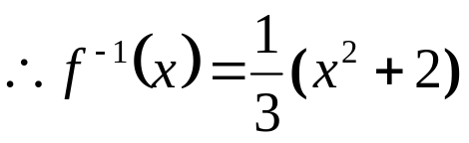
# Find a formula for the inverse of with x as the
independent variable, and state the domain of f ^{─1}.
Solution: Given
Then we solve this equation for x as a function of y:
We know that the domain of f ^{─1} is the range of f.
Therefore the domain of f ^{─1} is [0, +∞)

Slide 15
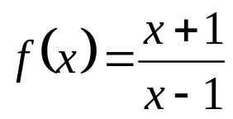
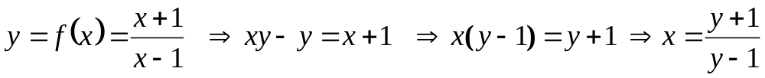
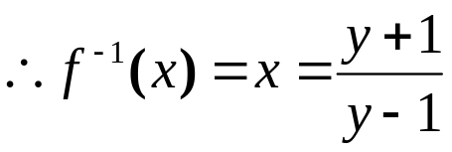
# Find domain and range of the following function
Solution:
Here the function y = f(x) is defined if x − 1 ≠ 0 ⇒ x ≠ 1
∴ Domain, D_{f} = {x : x ≠ 1} =(− ∞, 1) ∪ (1, +∞) = ℝ − {1}
Now,
The function f ⁻¹(x) is defined if y −1≠ 0 i.e. y ≠ 1.
∴ Domain of f ⁻¹(x) = (− ∞, 1) ∪ (1, ∞) = Range of f (x) . ▄

Slide 16
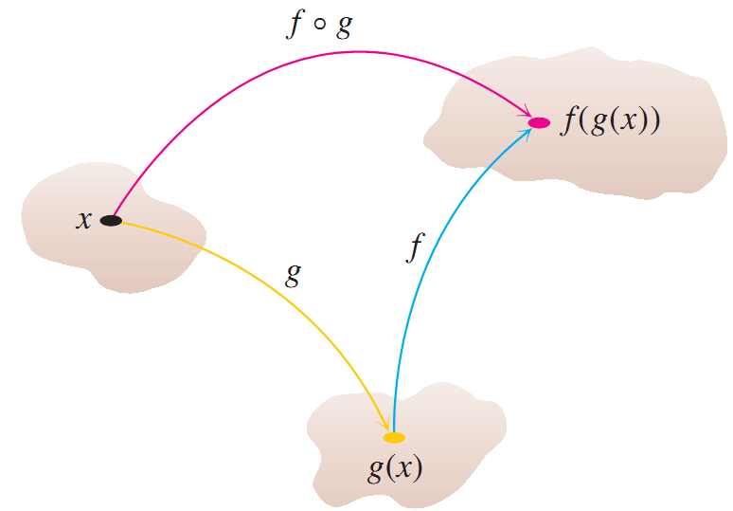
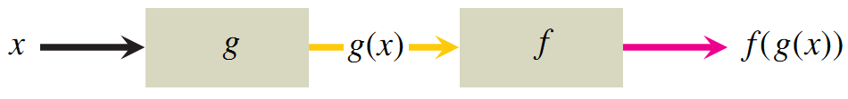
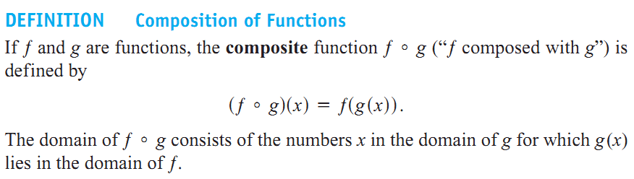
COMPOSITE FUNCTIONS:

Slide 17
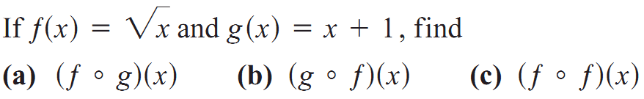
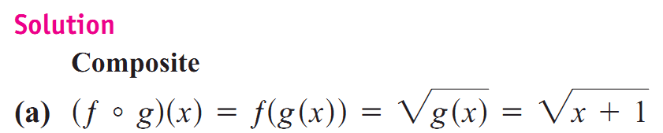
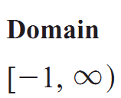




#
NOTE:
(─ ∞, + ∞)
[0, + ∞)
Domain is [0, + ∞) not (─ ∞, + ∞)

